Slide 1
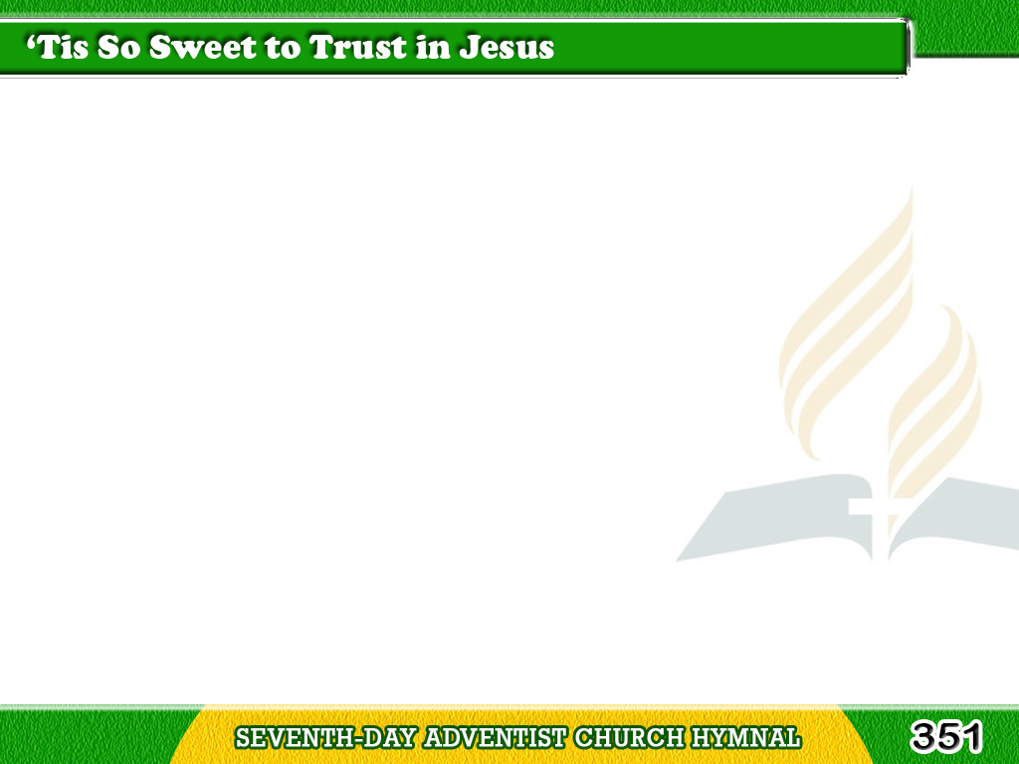
1/4
‘Tis so sweet to trust in Jesus,
Just to take Him at His word;
Just to rest upon His promise,
Just to know,
“Thus saith the Lord.”
Tagalog
Version

Slide 2
1/4
Chorus
Jesus, Jesus, how I trust Him;
How I’ve proved Him
o’er and o’er!
Jesus, Jesus, precious Jesus!
O for grace to trust Him more!
Tagalog
Version

Slide 3
2/4
O how sweet to trust in Jesus,
Just to trust His cleansing blood;
Just in simple faith to plunge me
‘Neath the healing,
cleansing flood.
Tagalog
Version

Slide 4
2/4
Chorus
Jesus, Jesus, how I trust Him;
How I’ve proved Him
o’er and o’er!
Jesus, Jesus, precious Jesus!
O for grace to trust Him more!
Tagalog
Version

Slide 5
3/4
Yes, ‘tis so sweet
to trust in Jesus,
Just from sin and self to cease;
Just from Jesus simply taking
Life, and rest, and joy, and peace.
Tagalog
Version

Slide 6
3/4
Chorus
Jesus, Jesus, how I trust Him;
How I’ve proved Him
o’er and o’er!
Jesus, Jesus, precious Jesus!
O for grace to trust Him more!
Tagalog
Version

Slide 7
4/4
I’m so glad I learned
to trust Thee,
Precious Jesus, Savior, Friend;
Tagalog
Version

Slide 8
4/4
And I know that
Thou art with me,
Wilt be with me till the end.
Tagalog
Version

Slide 9
4/4
Chorus
Jesus, Jesus, how I trust Him;
How I’ve proved Him
o’er and o’er!
Jesus, Jesus, precious Jesus!
O for grace to trust Him more!
Tagalog
Version

